Slide 1
CMSC201 Computer Science I for Majors Lecture 10 – Functions

Slide 2
Last Class We Covered
Using for loops
Syntax
Using it to iterate over a list
Using it for “counting” the number of actions
The range() function
Syntax
Three forms: one, two, or three numbers

Slide 3
Any Questions from Last Time?

Slide 4
Today’s Objectives
To learn why you would want to divide your code into smaller, more specific pieces (functions!)
To be able to define new functions in Python
To understand the details of function calls and parameter passing in Python
To use functions to reduce code duplication and increase program modularity

Slide 5
Review: Looping and range()

Slide 6
Review of range() Function
for i in range(5):
print(i)
0
1
2
3
4
What is the output of this code?
Range generates a list of numbers up to (but not including) the number

Slide 7
Review of range() Function
for i in range(-3, -13, -3):
print(i)
-3
-6
-9
-12
What is the output of this code?
With three inputs, we can change the step to a negative to let us count down

Slide 8
Differences Between the Loops
Though they are both loops, for loops and while loops behave very differently
What does the loop do?
for loop:
Iterate over a list
while loop:
Evaluate a conditional
Even when we use range()
What?!
Remember, range() creates a list of numbers!

Slide 9
Differences Between the Loops
What is the syntax of the loop?
for loop:
for listVariable in listName:
Must contain list name and a list variable
while loop:
while CONDITIONAL (== True):
Must use a conditional that contains a variable that changes as the loop is run

Slide 10
Differences Between the Loops
How is the loop variable updated?
for loop:
The loop itself updates the loop variable
First time through, it is element at index 0; second time through, element at index 1; etc.
while loop:
Programmer must update the loop variable
Updating is not done automatically by Python

Slide 11
Infinite Loops
An infinite loop is a loop that will run forever
Can we have an infinite loop using for?
No! The for loop goes through a set number of steps (iterating or counting) and will always end
Can we have an infinite loop using while?
Yes! The while loop’s loop variable is controlled by us, and we can make mistakes

Slide 12
Control Structures (Review)
A program can proceed:
In sequence
Selectively (branching): make a choice
Repetitively (iteratively): looping
By calling a function
focus of today’s lecture

Slide 13
Introduction to Functions

Slide 14
Functions We’ve Seen
We’ve actually seen (and used) two different types of functions already!
Built-in Python functions
For example: print(), input(), casting, etc.
Our program’s code is contained completely inside the main() function
A function that we created ourselves

Slide 15
Parts of a Function
The output:
bash-4.1$ python test.py
5
<class 'int'>
bash-4.1$
use “def” to create a function
def main():
a = 5
print(a)
print(type(a))
main()
function body
calls “print” function
calls “type” function
calls “main”

Slide 16
Why Use Functions?
Functions reduce code duplication and make programs more easy to understand and maintain
Having identical (or similar) code in more than one place has various downsides:
Don’t want to write the same code twice (or more)
The code must be maintained in multiple places
Code is harder to understand with big blocks of repeated code everywhere

Slide 17
What are Functions?
A function is like a subprogram
A small program inside of a program
The basic idea:
We write a sequence of statements
And give that sequence a name
We can then execute this sequence at any time by referring to the sequence’s name

Slide 18
When to Use Functions?
It’s not an exact science, and there’s no hard rules on when to use functions
If you have a block of code that performs a specific task, that might make a good function
def debugList( theList ):
for i in range( len(theList) ):
print("At index", i, "list is",
theList[i])

Slide 19
When to Use Functions?
Functions are used when you have a block of code that you want to be able to:
Write only once and be able to use again
Example: getting input from the user
Call multiple times at different places
Example: printing out a menu of choices
Differ a little bit when you call it each time
Example: printing out a greeting to different people

Slide 20
Function Vocabulary
Function definition:
The part of the program that creates a function
For example: “def main():” and the lines of code that are indented inside of def main():
Function call (or function invocation):
When the function is used in a program
For example: “main()” or “print("Hello")”

Slide 21
Function Example

Slide 22
Note: Toy Examples
The example we’re going to look at today is something called a toy example
It is purposefully simplistic (and kind of pointless) so you can focus on:
The concept being taught
Not how the code itself works
Sadly, it has nothing to do with actual toys
Image from pixabay.com
Notes:
https://pixabay.com/en/robot-toy-robot-toy-red-key-295165/

Slide 23
“Happy Birthday” Program
Happy Birthday lyrics…
def main(): print("Happy birthday to you!") print("Happy birthday to you!") print("Happy birthday, dear Maya...") print("Happy birthday to you!")
Gives us this…
bash-4.1$ python birthday.py Happy birthday to you! Happy birthday to you! Happy birthday, dear Maya... Happy birthday to you!

Slide 24
Simplifying with Functions
Most of this code is repeated (duplicate code)
print("Happy birthday to you!")
We can define a function to print out that line
def happy():
print("Happy birthday to you!")
Let’s update our program to use this function

Slide 25
Updated “Happy Birthday” Program
The updated program:
def happy(): print("Happy birthday to you!")
def main(): happy() happy() print("Happy birthday, dear Maya...") happy()
main()

Slide 26
More Simplifying
This clutters up our main function, though
We could write a separate function that sings “Happy Birthday” to Maya, and call it in main()
def singMaya():
happy()
happy()
print("Happy birthday, dear Maya...")
happy()

Slide 27
New Updated Program
The new updated program:
def happy():
print("Happy birthday to you!")
def singMaya():
happy()
happy()
print("Happy birthday, dear Maya...")
happy()
def main():
singMaya() # sing Happy Birthday to Maya
main()

Slide 28
Updated Program Output
bash-4.1$ python birthday.py
Happy birthday to you!
Happy birthday to you!
Happy birthday, dear Maya...
Happy birthday to you!
bash-4.1$
Notice that despite all the changes we made to the code, the output is still exactly the same as before

Slide 29
Someone Else’s Birthday
Creating this function saved us a lot of typing!
What if it’s Luke’s birthday?
We could write a new singLuke() function!
def singLuke(): happy() happy() print("Happy birthday, dear Luke...") happy()

Slide 30
“Happy Birthday” Functions
def happy():
print("Happy birthday to you!")
def singMaya():
happy()
happy()
print("Happy birthday, dear Maya...")
happy()
def singLuke():
happy()
happy()
print("Happy birthday, dear Luke...")
happy()
def main():
singMaya() # sing Happy Birthday to Maya
print() # empty line between the two
singLuke() # sing Happy Birthday to Luke
main()

Slide 31
Updated Program Output
bash-4.1$ python birthday2.py
Happy birthday to you!
Happy birthday to you!
Happy birthday, dear Maya...
Happy birthday to you!
Happy birthday to you!
Happy birthday to you!
Happy birthday, dear Luke...
Happy birthday to you!
bash-4.1$
Image from pixabay.com
Notes:
https://pixabay.com/en/dogs-carnival-humor-pet-ernst-1190015/

Slide 32
Multiple Birthdays
This is much easier to read and use!
But… there’s still a lot of code duplication
The only difference between singMaya() and singLuke() is what?
The name in the third print() statement
We could combine these two functions into one by using something called a parameter

Slide 33
Function Parameters

Slide 34
What is a Parameter?
A parameter is a variable that is initialized when we call a function
We can create a generic sing() function that takes in a person’s name as a parameter
def sing(person): happy() happy() print("Happy birthday, dear", person + "...") happy()
parameter

Slide 35
“Happy Birthday” with Parameters
def happy():
print("Happy birthday to you!")
def sing(person):
happy()
happy()
print("Happy birthday, dear", person + "...")
happy()
def main():
sing("Maya")
print()
sing("Luke")
main()

Slide 36
“Happy Birthday” with Parameters
def happy():
print("Happy birthday to you!")
def sing(person):
happy()
happy()
print("Happy birthday, dear", person + "...")
happy()
def main():
sing("Maya")
print()
sing("Luke")
main()
parameter passed in
parameter being used
function call with parameter
function call with parameter

Slide 37
Updated Program Output
bash-4.1$ python birthday3.py
Happy birthday to you!
Happy birthday to you!
Happy birthday, dear Maya...
Happy birthday to you!
Happy birthday to you!
Happy birthday to you!
Happy birthday, dear Luke...
Happy birthday to you!
bash-4.1$
This looks the same as before!
That’s fine! We wanted to make our code easier to read and use, not change the way it works.

Slide 38
Exercise: Prompt for Name
How would we update the code in main() to ask the user for the name of the person?
Current code looks like this:
def main():
sing("Maya")
main()

Slide 39
Solution: Prompt for Name
How would we update the code in main() to ask the user for the name of the person?
Updated code looks like this:
def main():
birthdayName = input("Whose birthday? ")
sing(birthdayName)
main()
Nothing else needs to change – and the sing() function stays the same

Slide 40
Exercise Output
bash-4.1$ python birthday4.py
Whose birthday? UMBC
Happy birthday to you!
Happy birthday to you!
Happy birthday, dear UMBC...
Happy birthday to you!
bash-4.1$

Slide 41
How Parameters Work

Slide 42
Functions and Parameters
Each function is its own little subprogram
Variables used inside of a function are local to that function
Even if they have the same name as variables that appear outside that function
The only way for a function to see a variable from outside itself is for that variable to be passed as a parameter

Slide 43
Function Syntax with Parameters
A function definition looks like this:
def fxnName(formalParameters): # body of the function
function name: follows same syntax rules as variable names
(no special characters, can’t start with a number, no keywords, etc.)
the formal parameters that the function takes in – can be empty!

Slide 44
Formal Parameters
The formal parameters, like all variables used in the function, are only accessible in the body of the function
Variables with identical names elsewhere in the program are distinct from those inside the function body
We often call this the “scope” of a variable

Slide 45
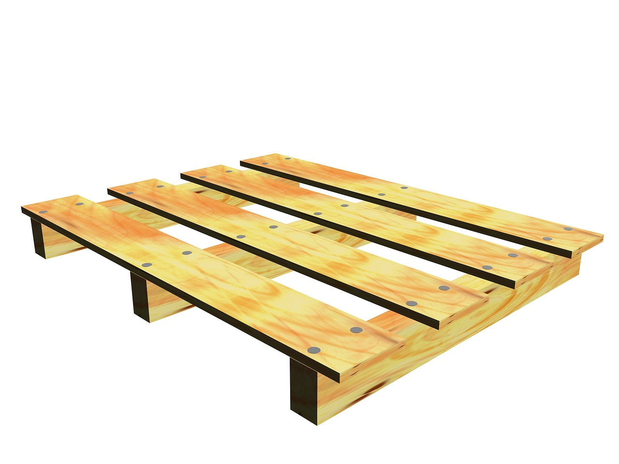
Scope
If variables are boxes, then a function and its variables are like a pallet that holds boxes
varA
varB
varA
varC
fxn1
fxn2
Notes:
https://pixabay.com/p-220256/
https://pixabay.com/p-686317/?no_redirect

Slide 46
Scope
If variables are boxes, then a function and its variables are like a pallet that holds boxes
Can hold unique values
varA
varB
varA
varC
fxn1
fxn2
Notes:
https://pixabay.com/p-220256/
https://pixabay.com/p-686317/?no_redirect

Slide 47
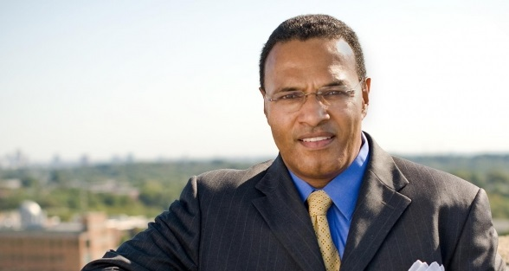
Example of Scope
This is our president, Freeman A. Hrabowski III
According to Wikipedia, he is a “a prominent American educator, advocate, and mathematician” and has been the President of UMBC since 1992
He will also take you up to the roof of the Admin building to show off the campus (it’s super cool)

Slide 48
Example of Scope
This is my (fictional) dog, a Chesapeake Bay Retriever also named Hrabowski
He is super cute, knows tons of tricks, and his favorite toy is his squeaky yellow duck
He also loves to spin in circles while chasing his tail
Image from pixabay.com
Notes:
https://pixabay.com/en/puppy-labrador-purebred-retriever-1082141/

Slide 49
Example of Scope
We have two very different things, both of which are called Hrabowski:
UMBC’s President Hrabowski
My (fictional) dog Hrabowski
If you go outside this classroom and tell someone “Hrabowski loves to chase his tail, it’s super cute” they will be very confused

Slide 50
Example of Scope
In the same way, a variable called person inside a function like sing() is a completely different variable from person in main()
The sing() function has one idea of what the person variable is, and main() has another
It depends on the context, or “scope” we are in

Slide 51
Calling Functions with Parameters

Slide 52
Calling with Parameters
In order to call a function with parameters, use its name followed by a list of variables
myFunction("my string", 17)
These variables are the actual parameters, or arguments, that are passed to the function

Slide 53
Python and Function Calls
When Python comes to a function call, it initiates a four-step process:
The calling program suspends execution at the point of the call
The formal parameters of the function get assigned the values supplied by the actual parameters in the call
The body of the function is executed
Control is returned to the point just after where the function was called

Slide 54
Code Trace: Parameters
Let’s trace through the following code:
sing("Maya") print() sing("Luke")
When Python gets to the line sing("Maya"), execution of main is temporarily suspended
Python looks up the definition of sing() and sees it has one formal parameter, person

Slide 55
Code Trace: Parameters
def happy():
print("Happy birthday to you!")
def sing(person):
happy()
happy()
print("Happy birthday, dear", person + "...")
happy()
def main():
sing("Maya")
print()
sing("Luke")
main()
formal parameter
actual parameter
actual parameter

Slide 56
Initializing Formal Parameters
The formal parameter is assigned the value of the actual parameter
When we call sing("Maya"), it as if the following statement was executed in sing()
person = "Maya"

Slide 57
Code Trace: Parameters
Next, Python begins executing the body of the sing() function
First statement is another function call, to happy() – what does Python do now?
Python suspends the execution of sing() and transfers control to happy()
The happy() function’s body is a single print() statement, which is executed
Control returns to where it left off in sing()

Slide 58
Code Trace: Parameters
Execution continues in this way with two more “trips” to the happy() function
When Python gets to the end of sing(), control returns to...
main(), which picks up...
where it left off, on the line immediately following the function call

Slide 59
Visual Code Trace
def main():
sing("Maya")
print()
sing("Luke")
"Maya"
def happy():
print("Happy BDay to you!")
def sing(person):
happy()
happy()
print("Happy BDay", person)
happy()
Note that the person variable in sing() disappeared after we exited the function!
person: "Maya"

Slide 60
Local Variables
When a function exits, the local variables (like person) are deleted from memory
If we call sing() again, a new person variable will have to be re-initialized
Local variables do not retain their value between function executions

Slide 61
Code Trace: Parameters
Next statement in main() is the empty call to print(), which simply produces a blank line
Python sees another call to sing(), so...
It suspends execution of main(), and...
Control transfers to…
the sing() function
With the actual parameter...
"Luke"

Slide 62
Visual Code Trace
def main():
sing("Maya")
print()
sing("Luke")
def sing(person):
happy()
happy()
print("Happy BDay", person)
happy()
"Luke"
person: "Luke"
The body of sing() is executed with the argument "Luke"
Including its three side trips to happy()
Control then returns to main()

Slide 63
Multiple Parameters

Slide 64
Multiple Parameters
One thing we haven’t discussed is functions with multiple parameters
When a function has more than one parameter, the formal and actual parameters are matched up based on position
First actual parameter becomes the first formal parameter, etc.

Slide 65
Multiple Parameters in sing()
Let’s add a second parameter to sing() that will take in the person’s age as well
And print out their age in the song
def sing(person, age):
happy()
happy()
print("Happy birthday, dear", person, "...")
print("You're", age, "years old now...")
happy()

Slide 66
Multiple Parameters in sing()
What will happen if we use the following call to the sing() function in main()?
def main():
sing("Maya", 46)
main()
It will print out:
Happy birthday to you!
Happy birthday to you!
Happy birthday, dear Maya...
You're 46 years old now...
Happy birthday to you!

Slide 67
Assigning Parameters
Python is simply assigning the first actual argument to the first formal argument, etc.
sing("Maya", 46) # function call
def sing(person, age):
# function body goes here

Slide 68
Parameters Out-of-Order
What will happen if we use the following call to the sing() function in main()?
def main():
sing(46, "Maya")
main()
It will print out:
Happy birthday to you!
Happy birthday to you!
Happy birthday, dear 46...
You're Maya years old now...
Happy birthday to you!

Slide 69
Parameters Out-of-Order
Python isn’t smart enough to figure out what you meant for your code to do
It only understands the exact code
That’s why it matches up actual and formal parameters based only on their order

Slide 70
Practice Problems
Write a function called avg() that takes in a list of numbers, calculates the average, and prints the result to the screen
Write a function that prints out the lyrics to a song – you can pick any song you like!
If it has a chorus, put that in a separate function, and call it when necessary

Slide 71
Announcements
Homework 4 is due Wednesday
Homework 2 grades went out Tuesday night
Homework 5 comes out this week
The midterm exam is fast approaching…
During your regular class on October 19th and 20th!
We’ll review in class on the 17th and 18th

